Slide 1
2023 CIBEL-SIDRA Joint Webinar
Dispute Resolution in the Belt & Road Initiative –
A New Model of Economic Governance?
An Opportunity to Develop a Beijing-Based
International Investment Dispute Resolution Hub
Prof. Mark Feldman
Peking University
School of Transnational Law
31 May 2023

Slide 2
A Potential Beijing-Based International Investment Dispute Resolution Hub:
Two Institutions
Asian Infrastructure Investment Bank (AIIB)
Established in 2015
Global membership (105 approved members, including 54 approved non-regional members)
Mission: (i) “foster sustainable economic development, create wealth and improve infrastructure connectivity in Asia by investing in infrastructure and other productive sectors” and (ii) “promote regional cooperation and partnership in addressing development challenges by working in close collaboration with other multilateral and bilateral development institutions” (AIIB Articles of Agreement, Article 1 (“Purpose”))
International Commercial Dispute Prevention and Settlement Organization (ICDPASO)
Established in 2020
Global membership (51 members covering Asia, Europe, Africa and the Americas) (includes commercial associations, legal service providers, universities, think tanks)
Services to include dispute prevention and dispute resolution; international commercial arbitration, investment treaty arbitration, mediation

Slide 3
BRI Dispute Resolution
BRI
“Silk Road Vision and Actions on Jointly Building Silk Road Economic Belt and 21st Century Maritime Silk Road”, Issued by the National Development and Reform Commission, Ministry of Foreign Affairs, and Ministry of Commerce of the People’s Republic of China, with State Council Authorization (March 2015)

Slide 4
BRI Dispute Resolution
Connections Between BRI and International Dispute Resolution
“Opinion Concerning the Establishment of the Belt and Road International Commercial Dispute Resolution Mechanism and Institutions” highlights:
International character of the BRI dispute resolution mechanism
Participation by experts in international law and domestic law of BRI participating countries
Fair and efficient resolution of cross-border commercial disputes arising in BRI context
Respect for party autonomy, including party preferences for different forms of dispute resolution
Emphasis on diversified dispute resolution - integrating litigation, arbitration and mediation services - which recognizes the diversity of legal cultures and systems in BRI participating countries
China International Commercial Court, ‘Opinion Concerning the Establishment of the Belt and Road International Commercial Dispute Resolution Mechanism’ (27 June 2018) (discussing Opinion issued by the General Office of the Communist Party Central Committee and the General Office of the State Council of the People’s Republic of China)

Slide 5
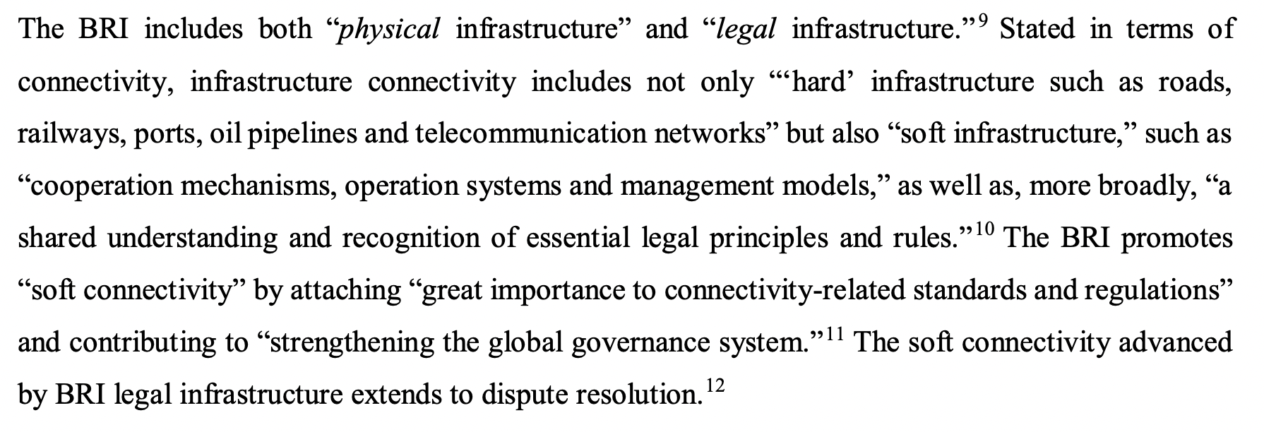
BRI Dispute Resolution
BRI “Dispute Resolution Connectivity”
M. Feldman, ‘Connectivity and Decoupling: Belt and Road Dispute Resolution in a Fractured Trade Environment’, Indian Rev. Int’l Arb. Vol. 1 Issue 1 (2021) (citing Chief Justice Sundaresh Menon, The Settlement of International Commercial Disputes: Alternative Dispute Resolution, Commercial Courts, and the Convergence of Commercial Laws, National Judges College (Beijing) (29 Aug.2019); Liao Fan, ‘Understanding the BRI through “Five Connectivities”’, CGTN (20 Apr. 2019); Heng Wang, ‘China’s Approach to the Belt and Road Initiative: Scope, Character and Sustainability’, 22 J. Intl’l Econ. L. 29 (2019); Ning Jizhe, Vice Chairman, National Development and Reform Commission (Oct. 2019), in Harmonizing Investment and Financing Standards towards Sustainable Development Along the Belt and Road, China Development Bank and United Nations Development Programme (2019))

Slide 6
BRI Dispute Resolution?
AIIB
BRI and AIIB both announced in 2013
Common goal of advancing infrastructure development in Asia
Substantial overlap between AIIB membership and BRI participation
Overlap reinforced by collaboration with Silk Road Fund to finance broadband network project in Oman
But co-financing with other multilateral development banks (MDBs) common for AIIB (through 2019, 49% of AIIB’s approved projects co-financed with other MDBs)
About one-third of all AIIB funding has been received by a State that does not participate in BRI (India).
The AIIB finances projects “both within and outside the places covered by the Belt and Road Initiative.”
AIIB President Jin Liqun: “We operate by our standards, by our governance. The Belt and Road Initiative is a marvelous program . . . but we have our standards.”
‘Silk Road Fund Entered into a Participation Agreement with Asian Infrastructure Investment Bank (AIIB) for Oman’s National Fiber Optic Broadband Network Project’ (Silk Road Fund, 7 November 2018),
C Humphrey, ‘From Drawing Board to Reality: The First Four Years of Operations at the Asian Infrastructure Investment Bank and New Development Bank’ (2020) Working Paper of the G-24 and Global Development Policy Center of Boston University,
A Krishnan, ‘“One-Third of Funding by AIIB Has Gone to India”’ The Hindu (26 September 2020)
GJ Sanders, ‘The Asian Infrastructure Investment Bank and the Belt and Road Initiative: Complementarities and Contrasts’ (2017) 16 Chinese Journal of International Law 367, 368.
E Glenn, ‘China-Backed AIIB Touts Growth, Sustainability’ Reuters (17 June 2017)
M Feldman, The AIIB as a Site of Governance, Advancing the Method and Practice of Transnational Law – Liber Amicorum in Honour of Francis Snyder (J. Chaisse and O. Stefan, eds.) (Hart) (forthcoming 2023)

Slide 7
BRI Dispute Resolution?
ICDPASO
List of Deliverables of the Second Belt and Road Forum for International Cooperation (27 April 2019)
III. Multilateral Cooperation Mechanisms under the BRF Framework

Slide 8
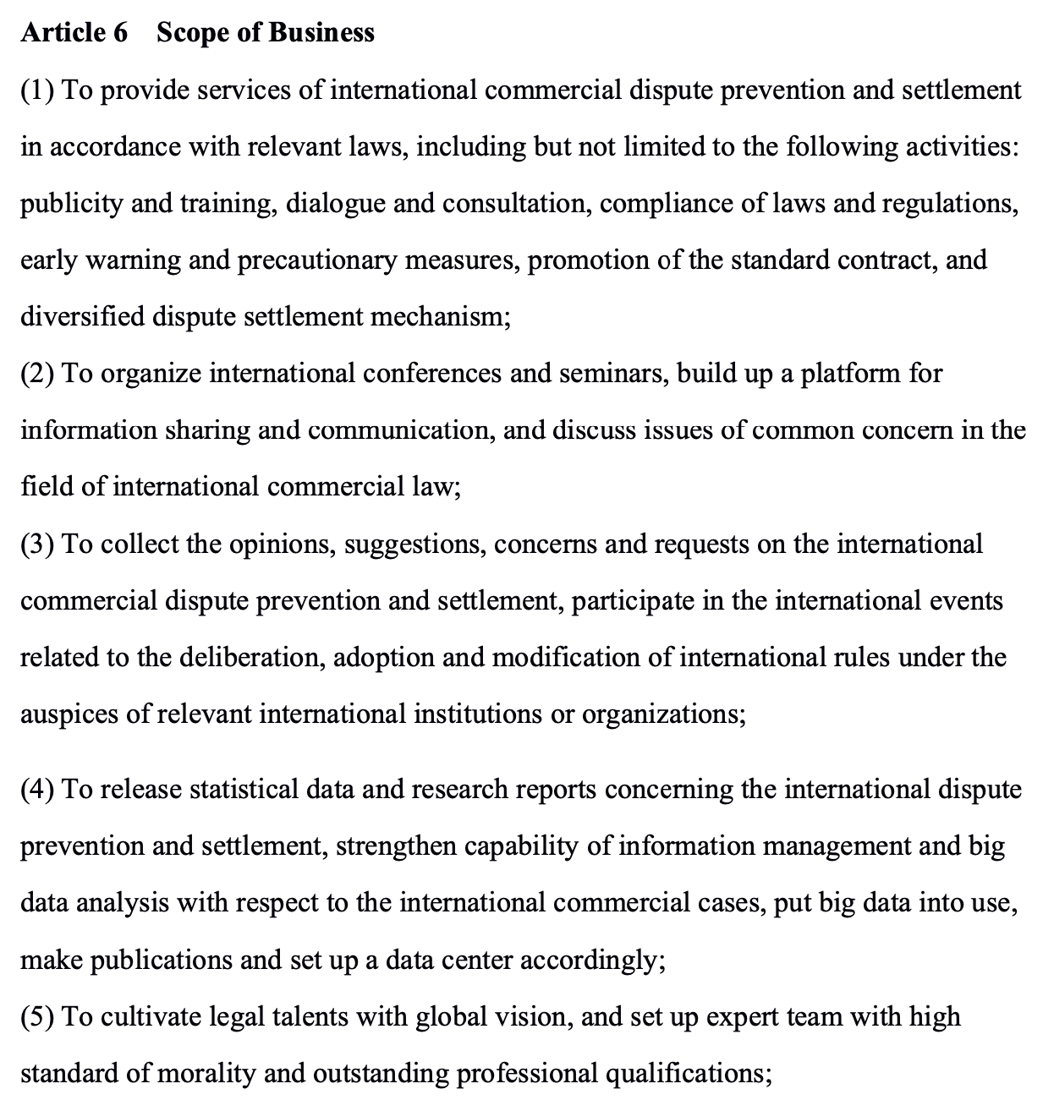
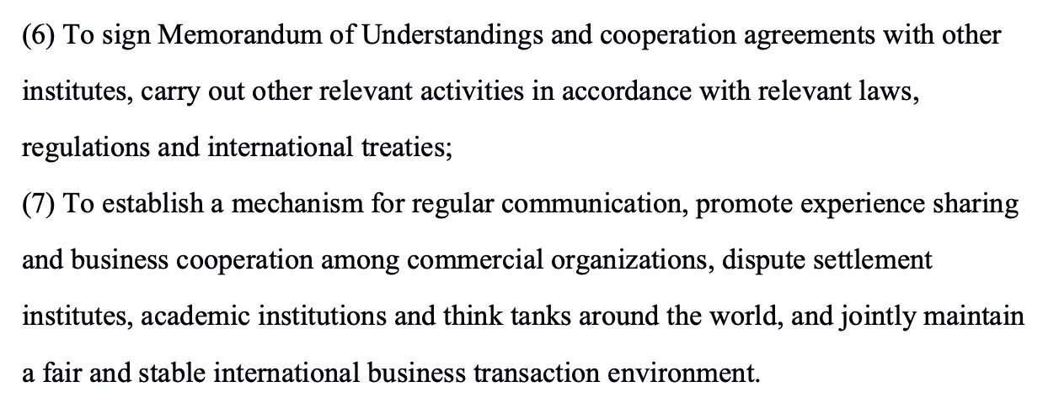
BRI Dispute Resolution?
ICDPASO
ICDPASO Charter

Slide 9
A Potential Beijing-Based
International Investment Dispute Resolution Hub
ICDPASO
Completed drafting a set of investor-State arbitration rules in 2021
Also in 2021, committed to launching investor-State arbitration services “in a timely manner in response to the needs of the international business community.”
In 2022, launched global recruitment process for arbitrators
M. Feldman, ‘An Opportunity to Reimagine Investment Arbitration in Beijing’, Columbia FDI Perspectives (20 March 2023); Speech by Liu Chao, Secretary-General of the ICDPASO, World Law Congress Colombia 2021 (3 December 2021)

Slide 10
A Potential Beijing-Based
International Investment Dispute Resolution Hub
ICDPASO – Opportunity to Develop Distinctive Approach to Investment Treaty Arbitration
Greater emphasis on alternatives to arbitration through dispute prevention and mediation services
Greater levels of institutionalization (through appellate scrutiny of awards)
Greater regional diversity, with strong representation from Asia
M. Feldman, ‘An Opportunity to Reimagine Investment Arbitration in Beijing’, Columbia FDI Perspectives (20 March 2023)

Slide 11
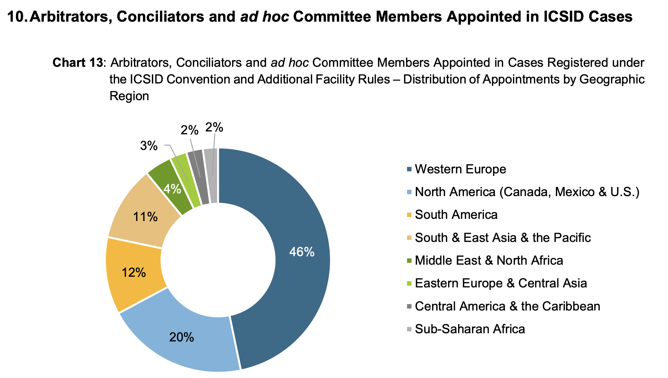
A Potential Beijing-Based
International Investment Dispute Resolution Hub
ICDPASO – Opportunity to Develop Distinctive Approach to Investment Treaty Arbitration
Regional diversity – compare ICSID
The ICSID Caseload – Statistics (Issue 2023-1)

Slide 12
A Potential Beijing-Based
International Investment Dispute Resolution Hub
AIIB
More than 55 years after the conclusion of the ICSID Convention, opportunity to reimagine the role of a multilateral development bank in supporting international investment dispute resolution
The 2019 AIIB Yearbook of International Law examined “the role of international organizations in promoting effective dispute resolution,” including whether the AIIB was “well placed” to serve as a “modern ICSID” for BRI-related investment.
M. Feldman, ‘An Opportunity to Reimagine Investment Arbitration in Beijing’, Columbia FDI Perspectives (20 March 2023) (quoting Peter Quayle and Xuan Gao, ‘Introduction: international organizations and the promotion of effective dispute resolution,’ in AIIB Yearbook of International Law 2019) (discussing chapter by Malik Dahlan, who argued that the AIIB could serve as a “modern ICSID” for BRI disputes).

Slide 13
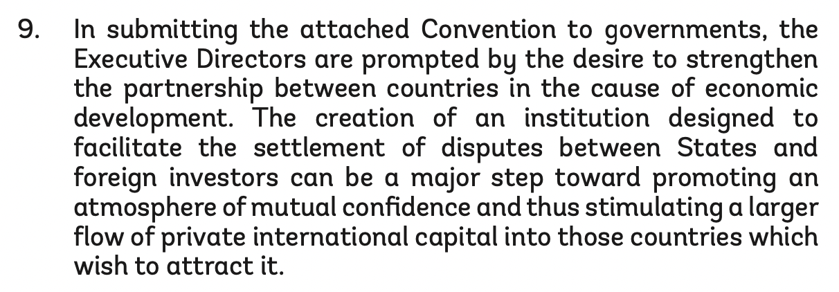
A Potential Beijing-Based
International Investment Dispute Resolution Hub
AIIB
Role of multilateral development bank in supporting international investment dispute resolution – compare ICSID (1965)
Report of the Executive Directors on the Convention on the Settlement of Investment Disputes Between States and Nationals of Other States (18 March 1965)

Slide 14
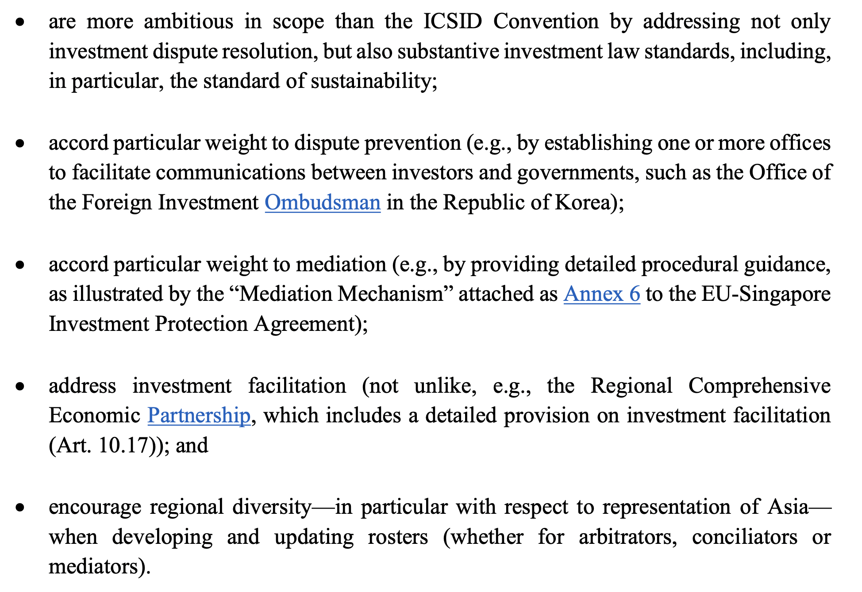
A Potential Beijing-Based
International Investment Dispute Resolution Hub
AIIB
Many opportunities for the AIIB to reimagine the role of a multilateral development bank in supporting international investment dispute resolution, including through the development of one or more instruments that:
M. Feldman, ‘An Opportunity to Reimagine Investment Arbitration in Beijing’, Columbia FDI Perspectives (20 March 2023)

Slide 15
A Potential Beijing-Based
International Investment Dispute Resolution Hub
The AIIB and ICDPASO: Potential Complementary, but not Identical, Paths in Advancing the Development of a Beijing-Based International Investment Dispute Resolution Hub
AIIB
Could closely consider the link between international investment and advancing infrastructure connectivity in Asia (just as linkages between international investment and economic development informed the ICSID Convention’s design)
In particular, the AIIB’s infrastructure connectivity mission could inform policy choices concerning the scope of covered “investors” and “investments”
ICDPASO
Could focus on procedural innovations, in particular by developing a novel international investment dispute resolution framework – offering a unique combination of service integration, institutionalization and regional diversity
M. Feldman, ‘An Opportunity to Reimagine Investment Arbitration in Beijing’, Columbia FDI Perspectives (20 March 2023)

